Slide 1
Final Project: The effect of IMF quota and governance reform
Yuki Wang

Slide 2
IMF quota and governance reform
The first round was from June 2006 - April 2008
The second round was from August 2009—July 2012
The third round was from August 2011—January 2013, but it is not until January 21, 2016 that the proposed amendment on reform of the Executive Board came into force.

Slide 3
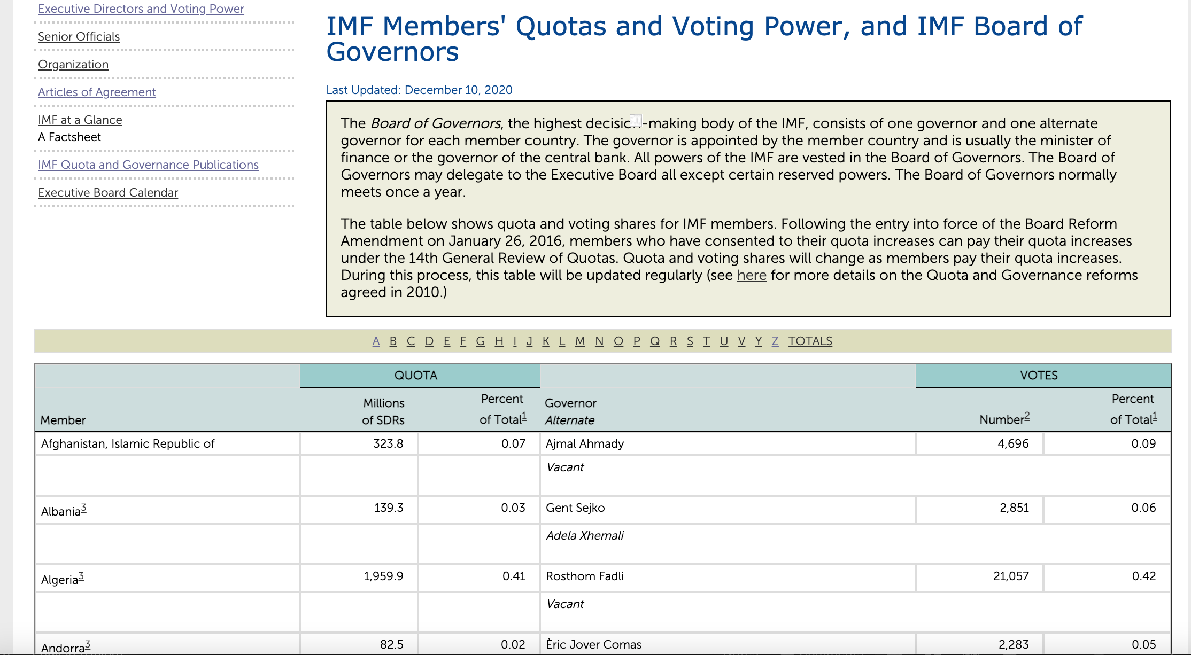
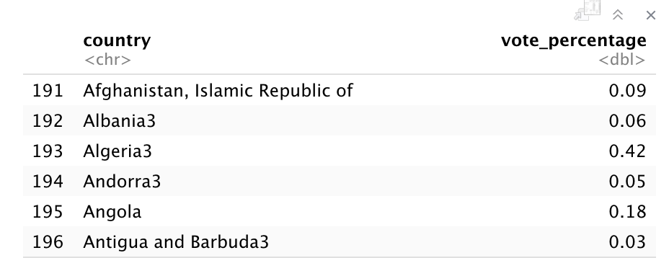
Collecting and pre-processing data1
IMF Members' Quotas and Voting Power, and IMF Board of Governors
https://www.imf.org/external/np/sec/memdir/members.aspx#Z

Slide 4
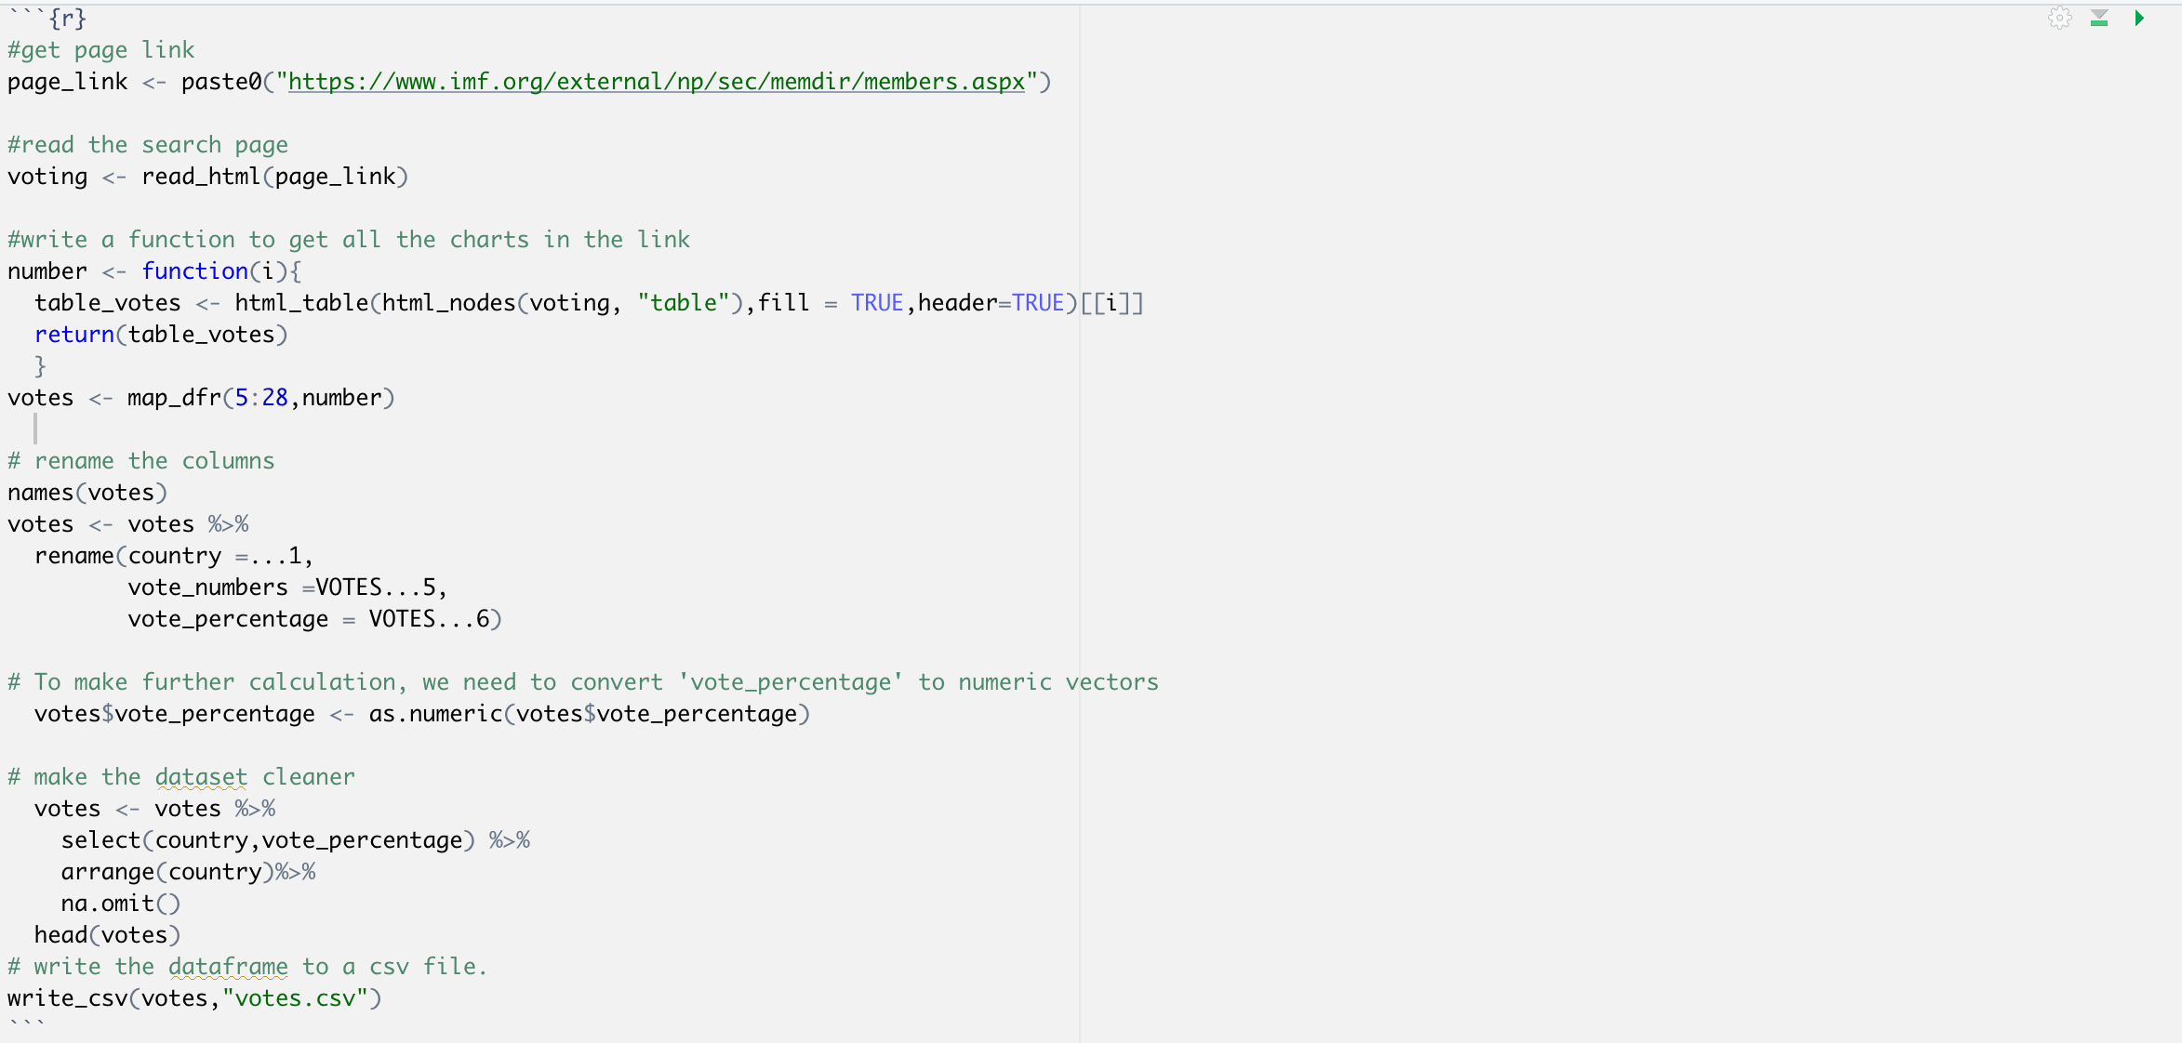
Code 1

Slide 5
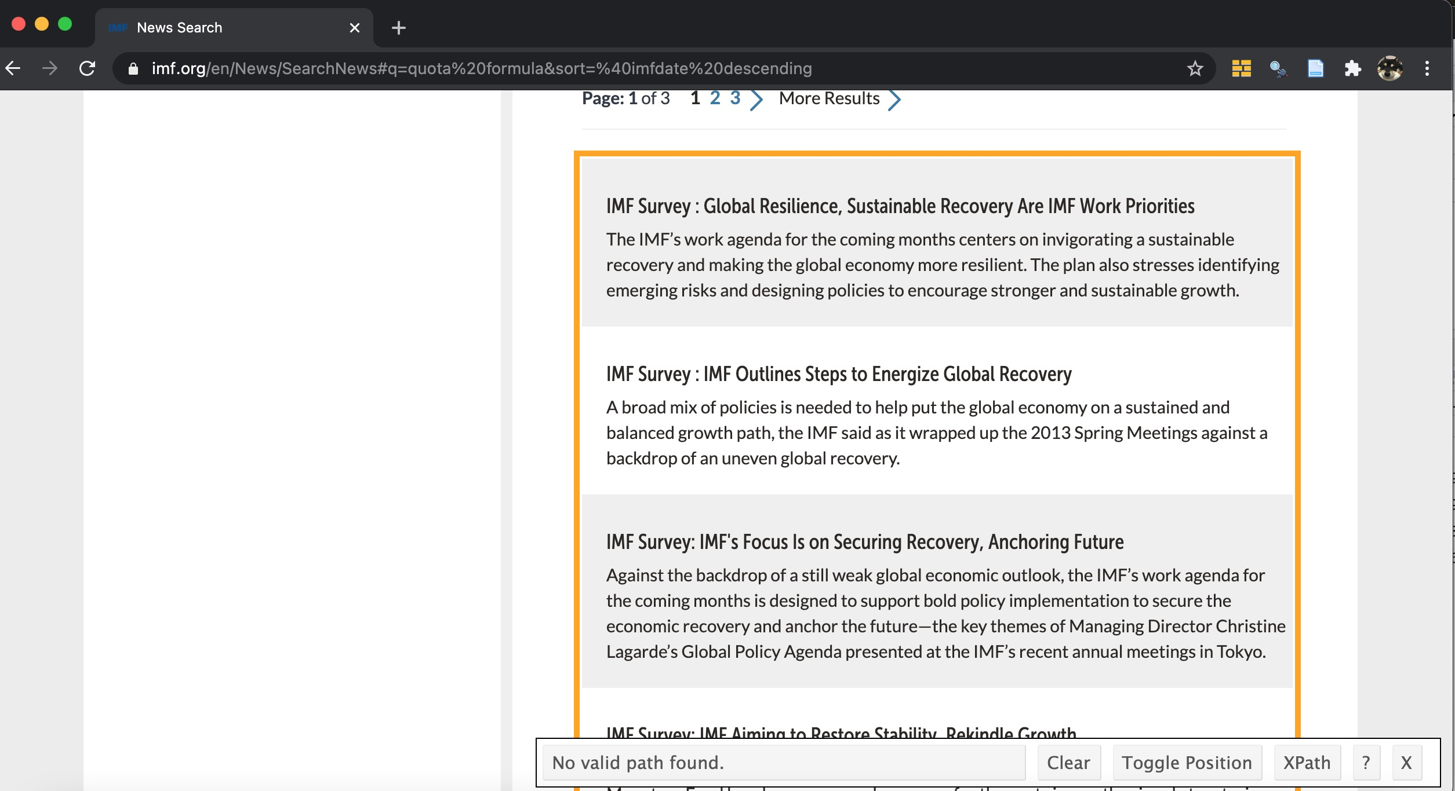
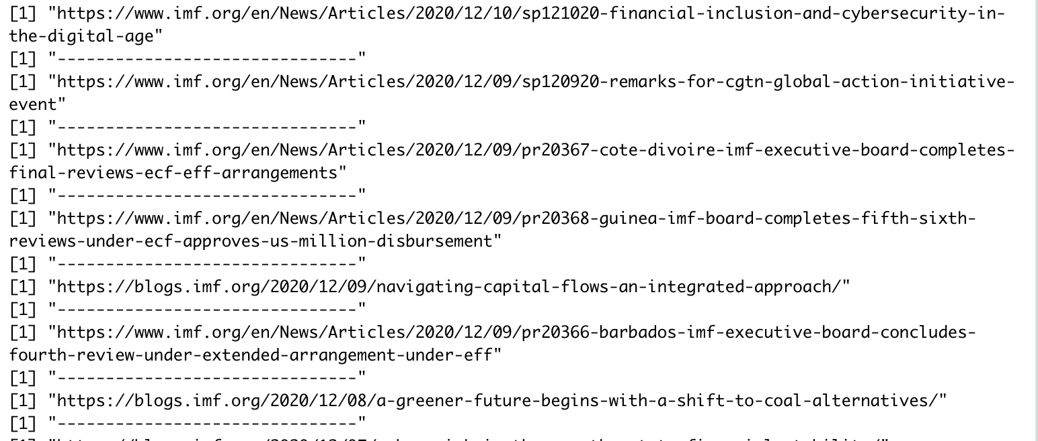
Collecting data2
collect data from the news section of the IMF website. Set the keyword as "quota formulas" ,the news type as "News article", and return the results. https://www.imf.org/en/News/SearchNews#q=quota%20formula&sort=%40imfdate%20descending

Slide 6
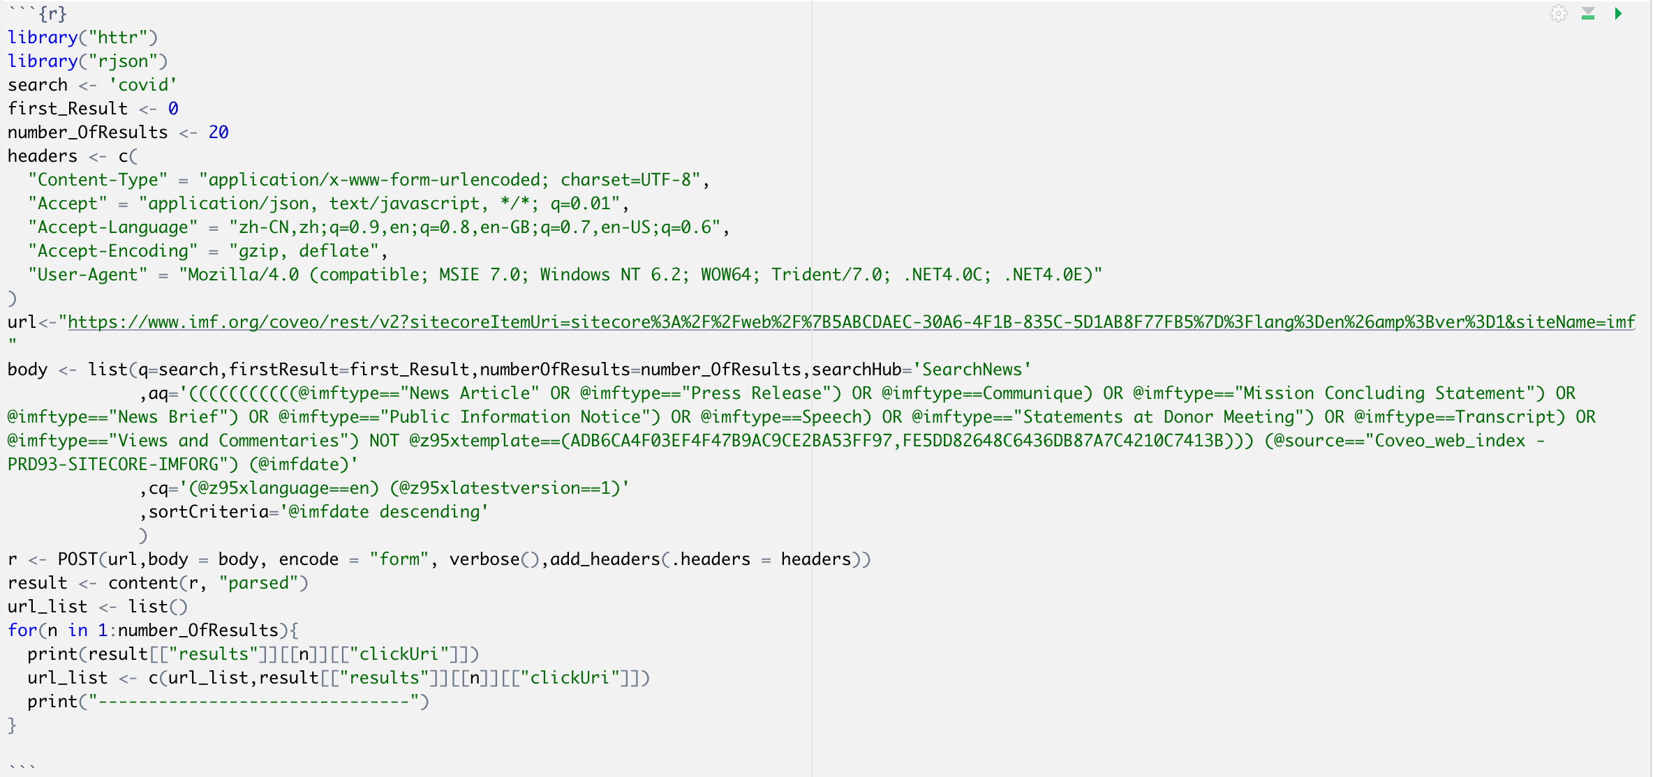
Code 2

Slide 7
Downloading data from the IMF and WB
IMF Quota and Governance Publications: Updated IMF Quota
https://www.imf.org/external/np/fin/quotas/2018/0818.htm
import the excel file as 'quotas’
IMF Monitoring of Fund Arrangements (MONA) Database
https://www.imf.org/external/np/pdr/mona/Country.aspx
import the excel file as 'arrangement’
World Bank Open Data
https://data.worldbank.org/indicator
import the excel file as 'CV'

Slide 8
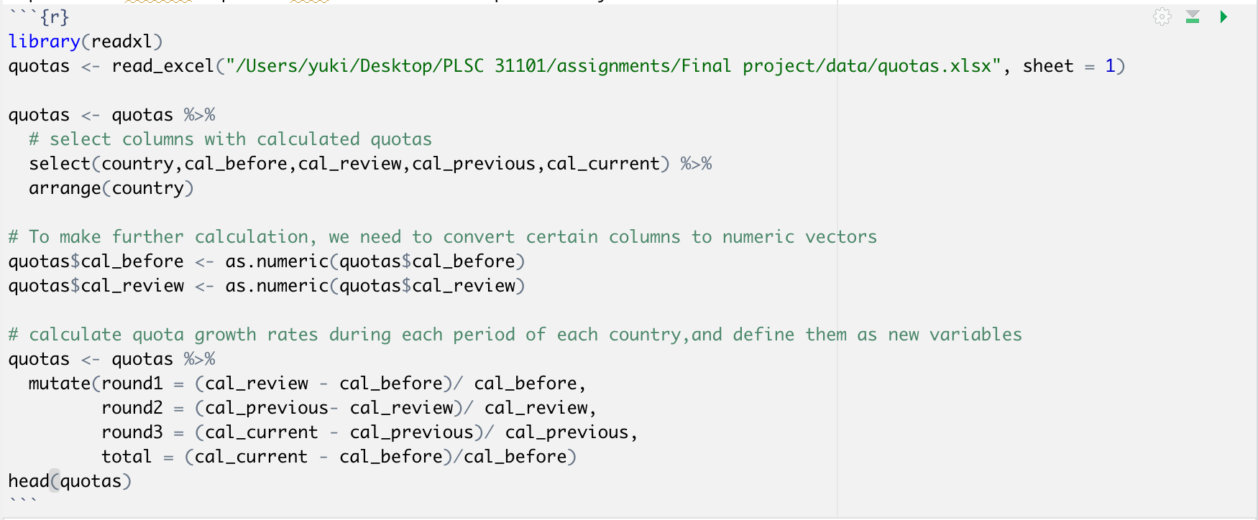
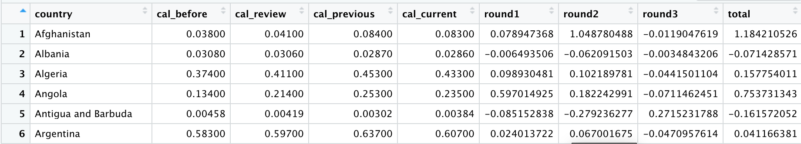
Code 3

Slide 9
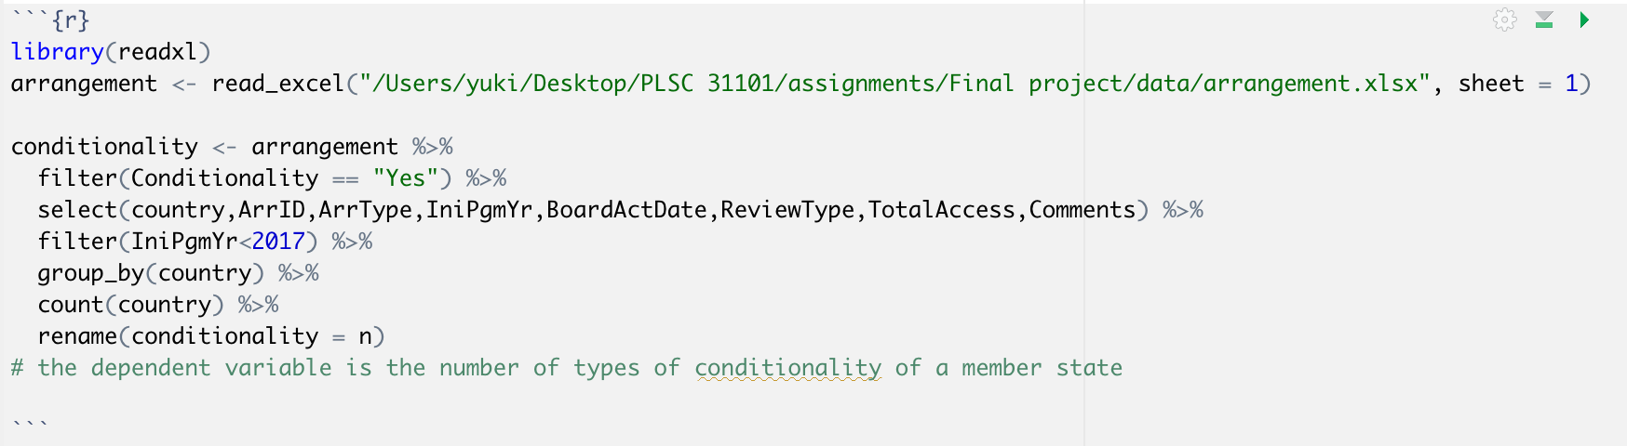
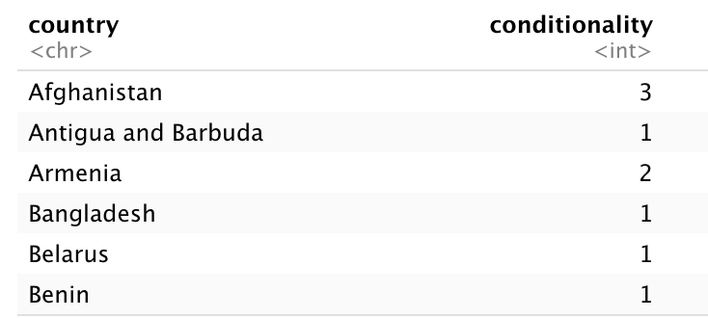
Code 4

Slide 10
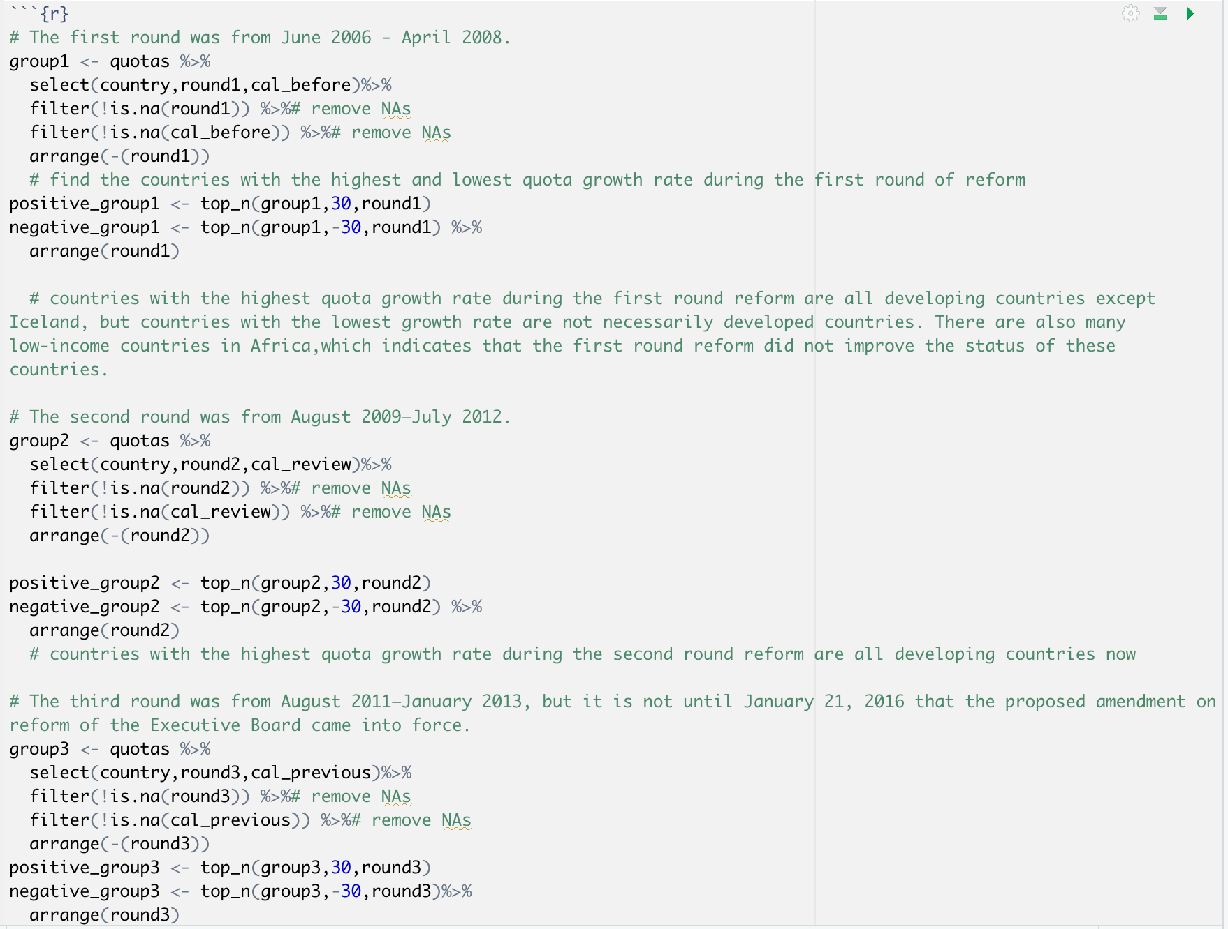
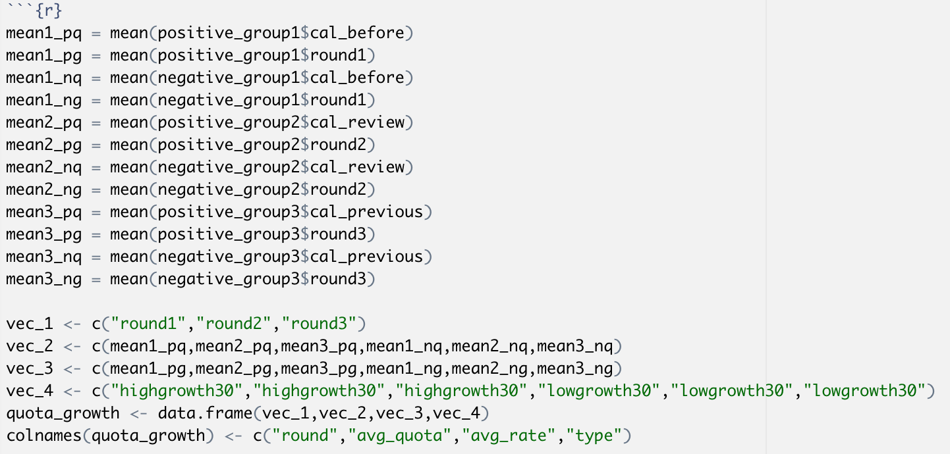
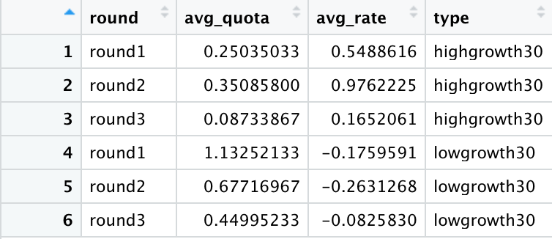
Creating a new dataframe for plotting

Slide 11
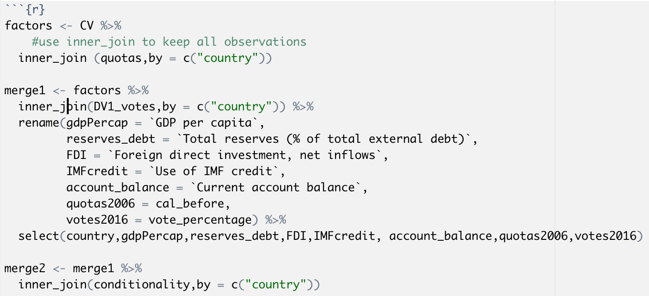
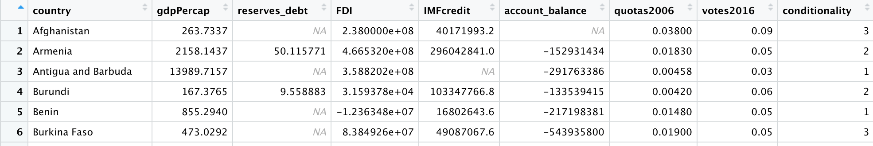
Merging datasets for regression

Slide 12
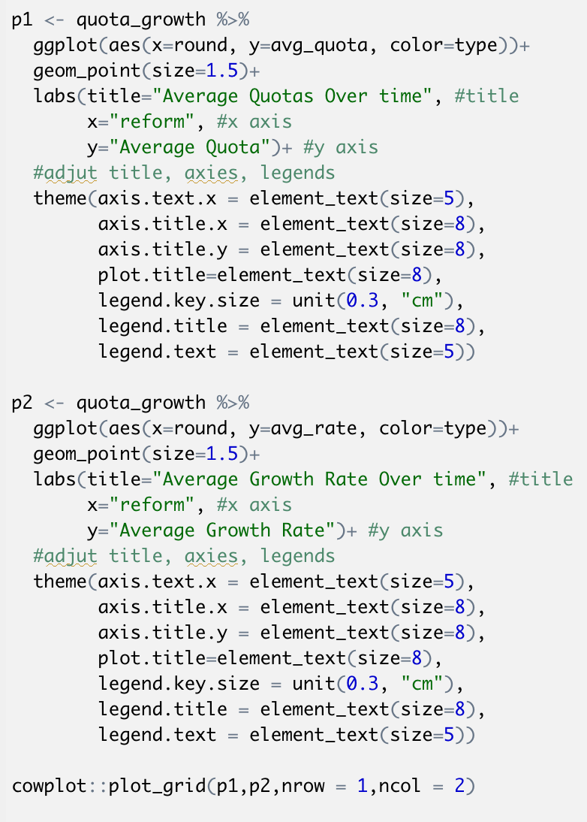
Analysis and Visualization

Slide 13
Analysis and Visualization

Slide 14
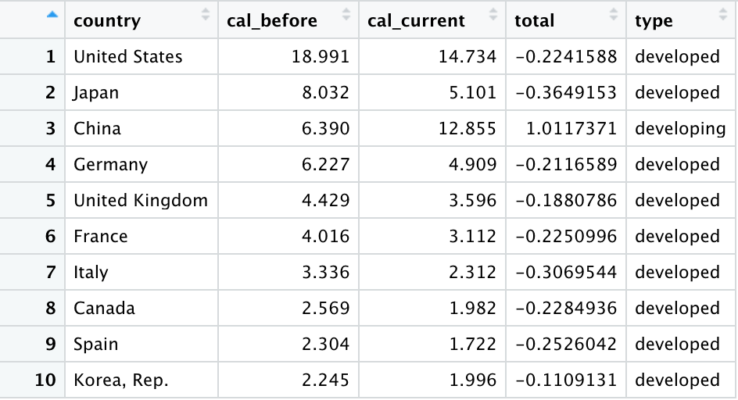
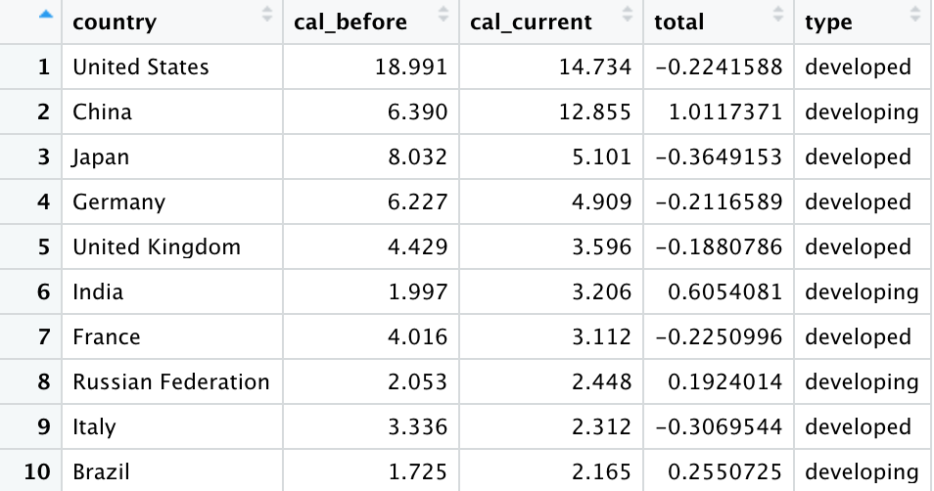
Analysis and Visualization

Slide 15
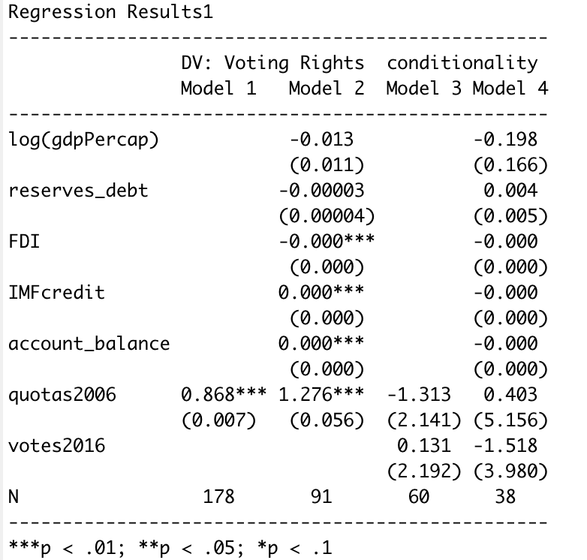
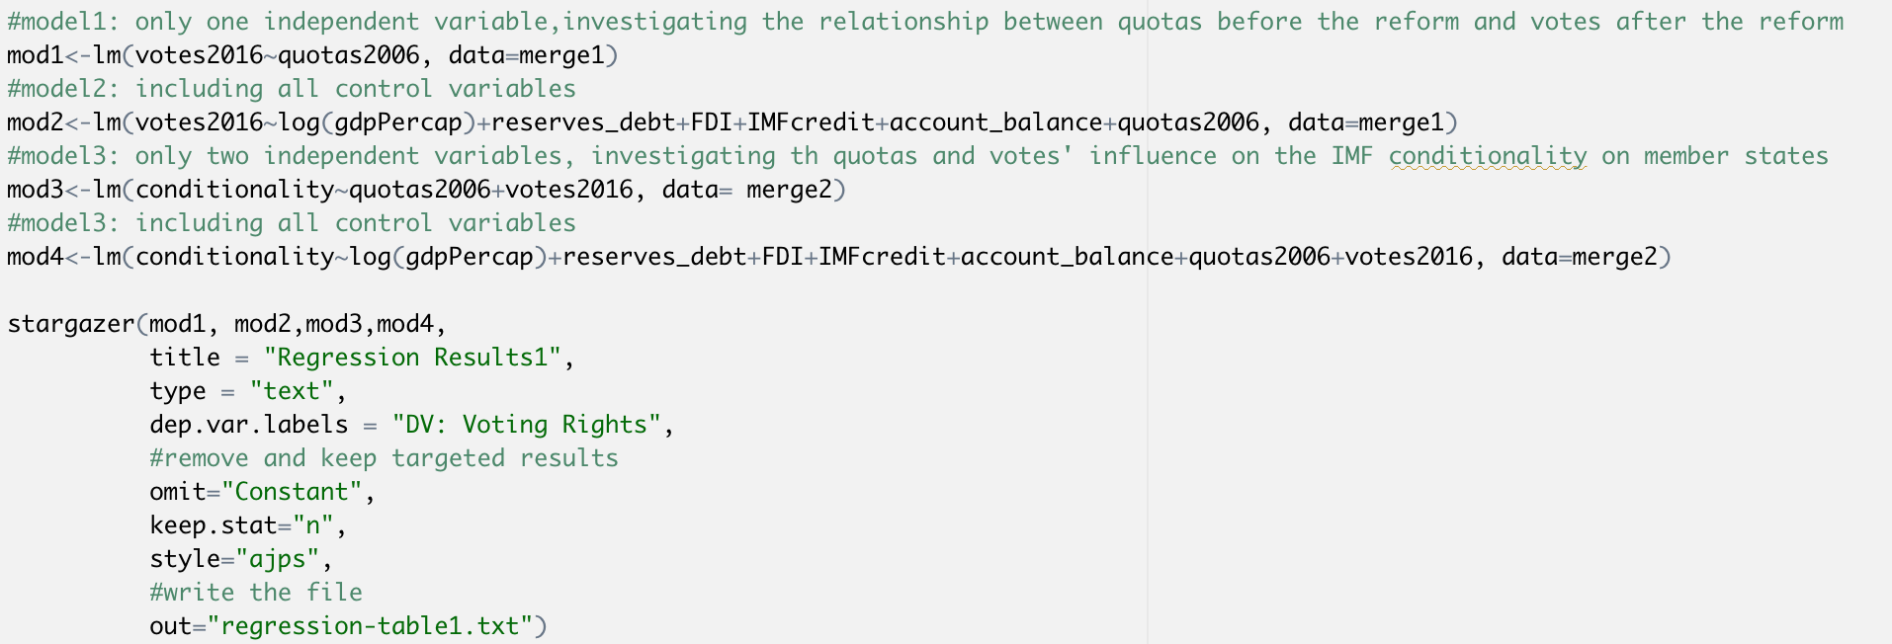
Analysis and Visualization

Slide 16
Thanks for your listening
Yuki Wang

